Slide 1
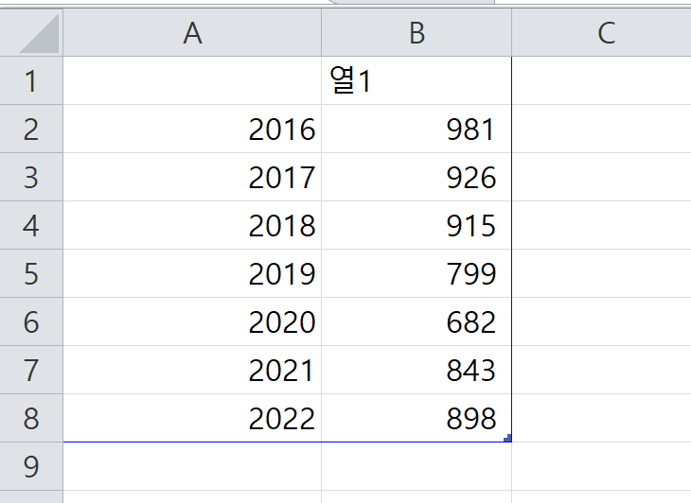
Notes:
`

Slide 2
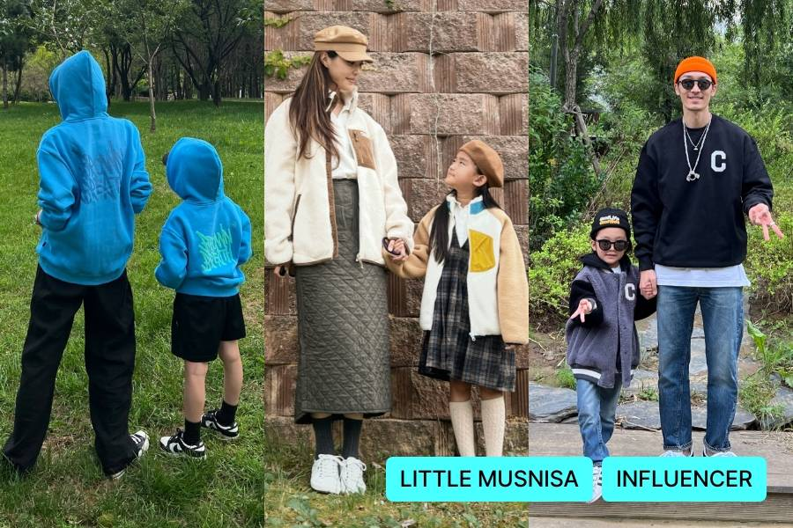
Family look on Musinsa
Notes:
`

Slide 3
Notes:
`

