Slide 1
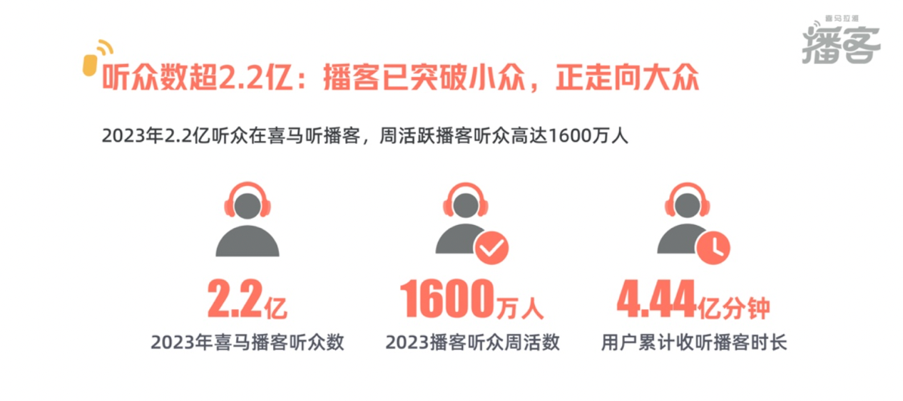
Original Source:
Daxue Template:
Himalaya: Podcasts are no longer niche and are becoming popular
220 million
16 million
444 million mins
Number of Himalaya listeners in 2023
Number of Weekly active podcast listeners in 2023
Cumulative podcast listening time
https://baijiahao.baidu.com/s?id=1787232418418242025&wfr=spider&for=pc

Slide 2
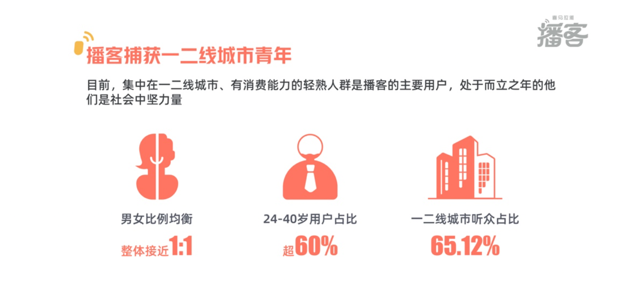
Original Source:
Daxue Template:
Himalaya: Podcast captures youth in first- and second-tier cities
around 1:1
more than 60%
65.12%
Balanced gender ratio
Percentage of listeners aged 24-40 years
Percentage of listeners in first- and second-tier cities
https://baijiahao.baidu.com/s?id=1787232418418242025&wfr=spider&for=pc

